Slide 1

Discipline: Your wings to soar. Design Thinking for Social Innovation Course Project
Ritesh Kulkarni | 736
Varun Vivek Pai | 737
Vaishnavi Mathad | 754
Vishwa Rachotimath | 756
Shreya Patil | 770
Under the guidance of
Dr. Tanuja V. Patil
2023-2024, Odd Semester
CEER, KLE Technological University, Hubballi

Slide 2
Empathy
LACK OF DISCIPLINE AMONG STUDENTS:
During the community visit, we found that the students of the government school lack awareness about the importance of studies and attendance. The school has a gate but since it is kept open during school hours, the students can leave the school anytime and there is nobody questioning them. Some students attend the school for the first two periods, give their attendance and leave the school during the break.

Slide 3
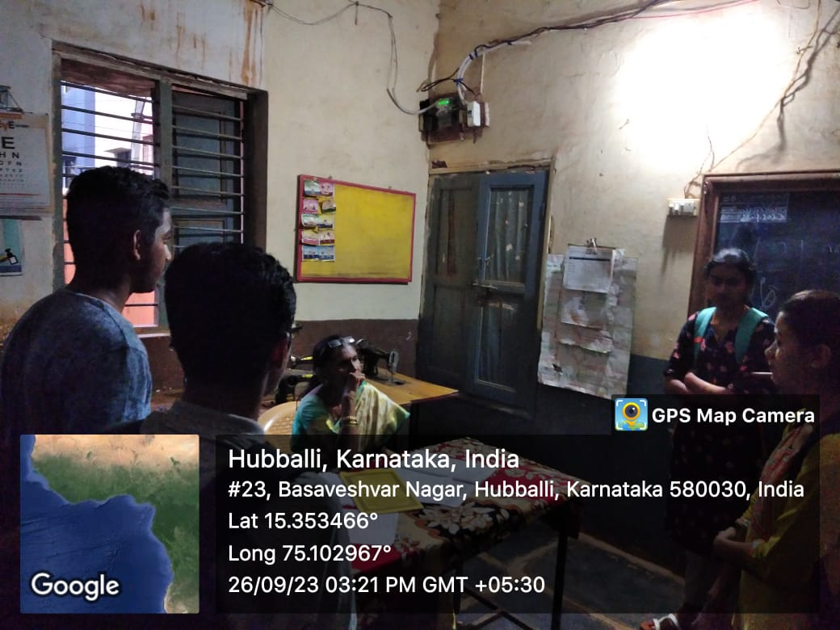
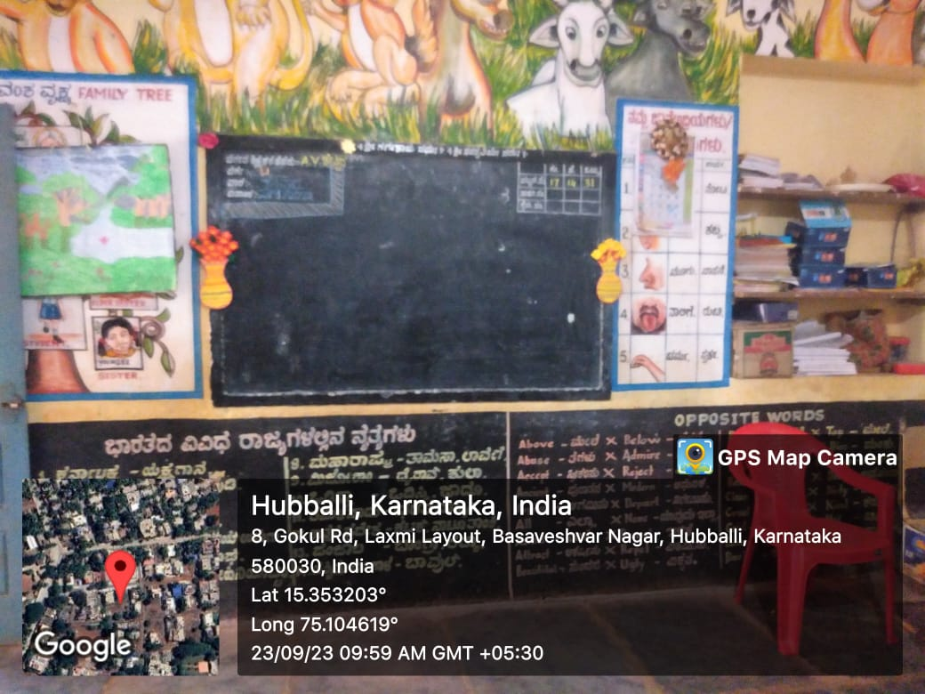

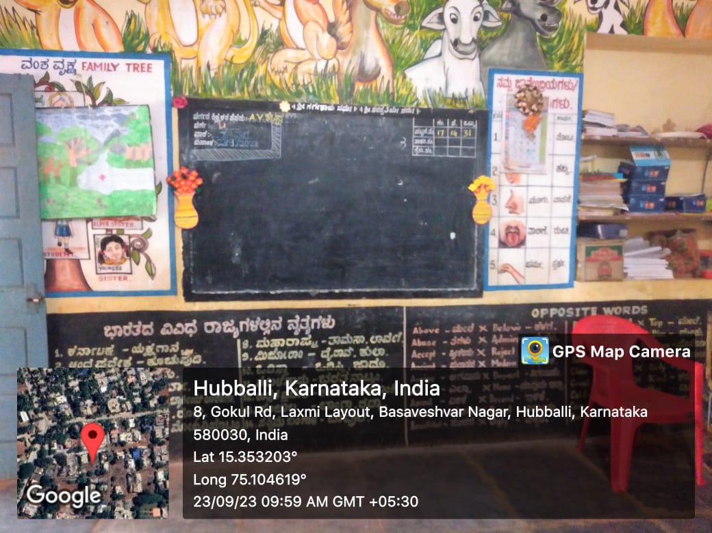
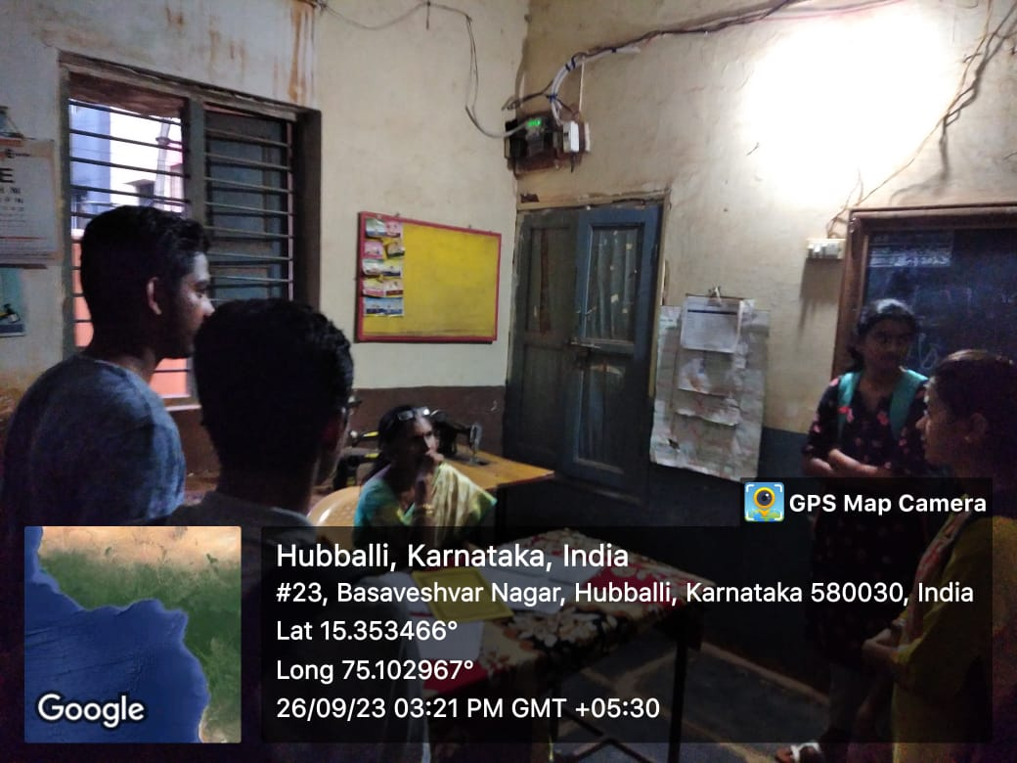
1
<Attach photos/videos of your community visit>
EMPATHY

Slide 4
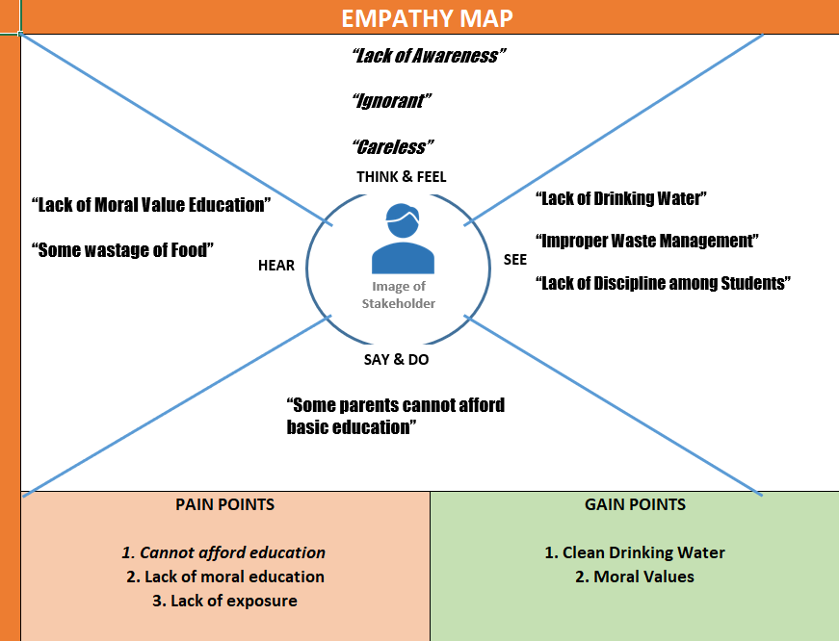
Empathy
Map

Slide 5
Social Problem articulation
[Students of Government High School , Basaveshwar Nagar ] faces a social challenge of [ lack of discipline ] because [ discipline always have been taught from Childhood of the student and it’s the most important in every student's carrier and also in professional life ]

Slide 6
Brainstorming
1. Teaching them basic things of discipline like handwash , classroom cleanliness , behaviour skills by mode of showing videos / short films or practicing by themselves .
2. Making two teams among student and competing among them to clean the class and corners of the school.
3.There are no dustbins, so we should allot dustbins in each class to keep the school’s environment clean .
4. We should educate the Children in the school about the importance of food .
5.Implementing some disciplinary activities like importance of English language which helps in professional carriers.
6. Conducting co-curricular activities : taking discipline as a main role such as team Games and some fun games meeting the disciplinary roles and conducting plays , dramas , etc .
7. To maintain attendance of students strictly , taking attendance twice a day .
8. Students must ensure some ground rules and awareness about homework and academics .

Slide 7

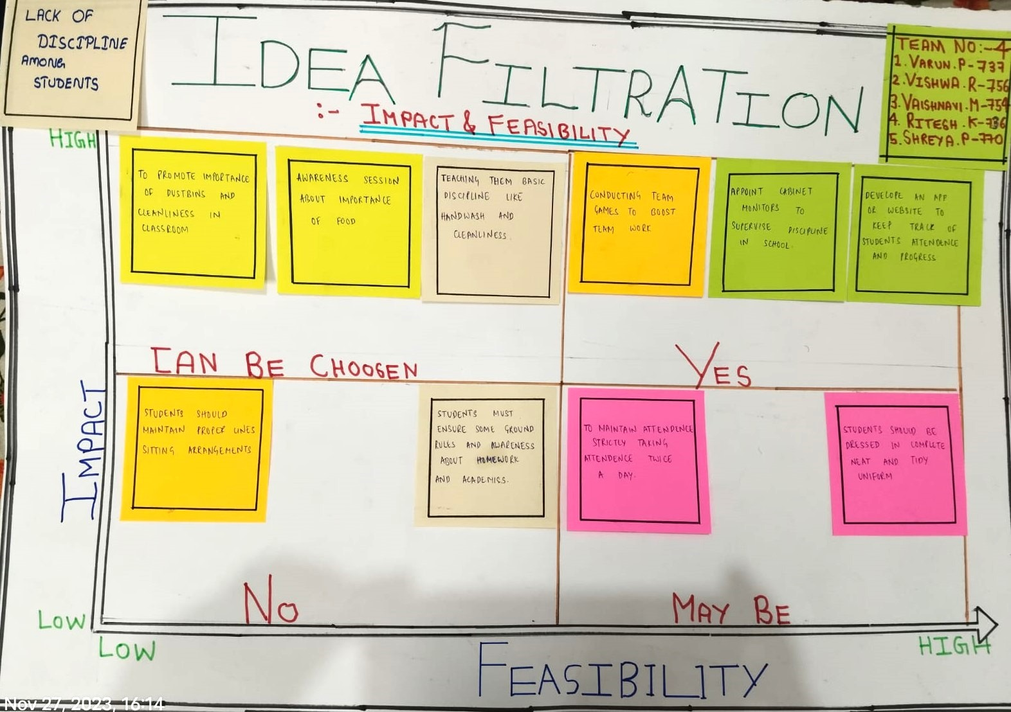
2
Social Problem articulation
Articulate the problem.

Slide 8
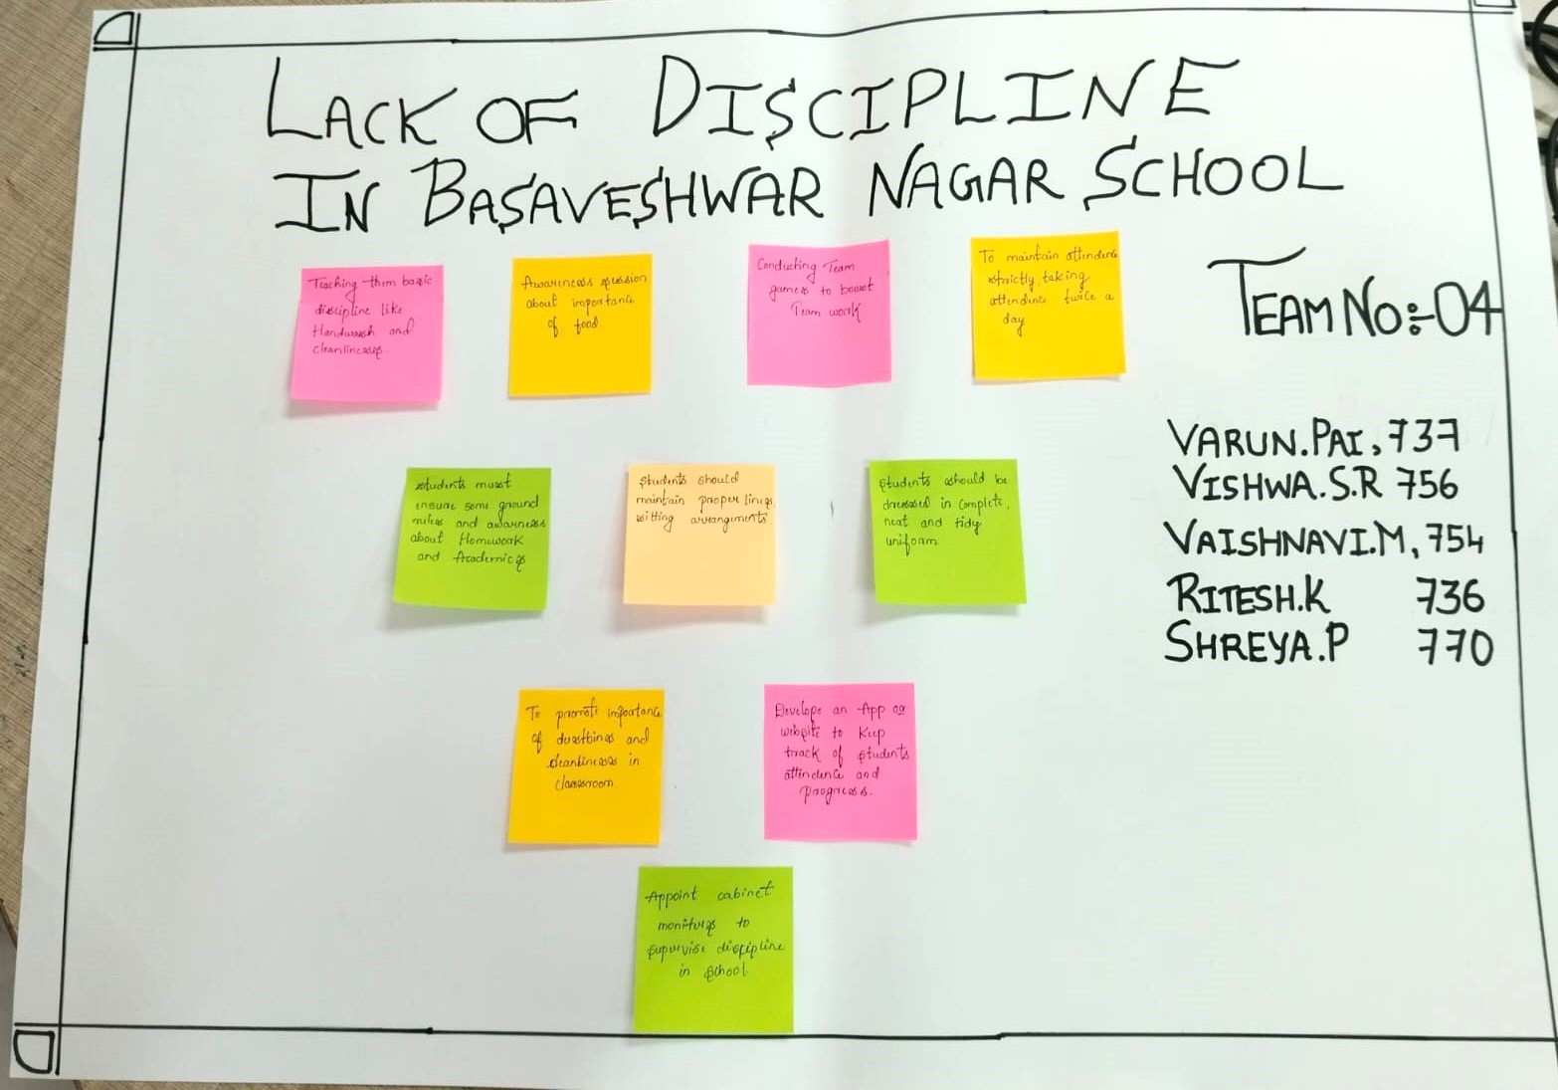

Slide 9
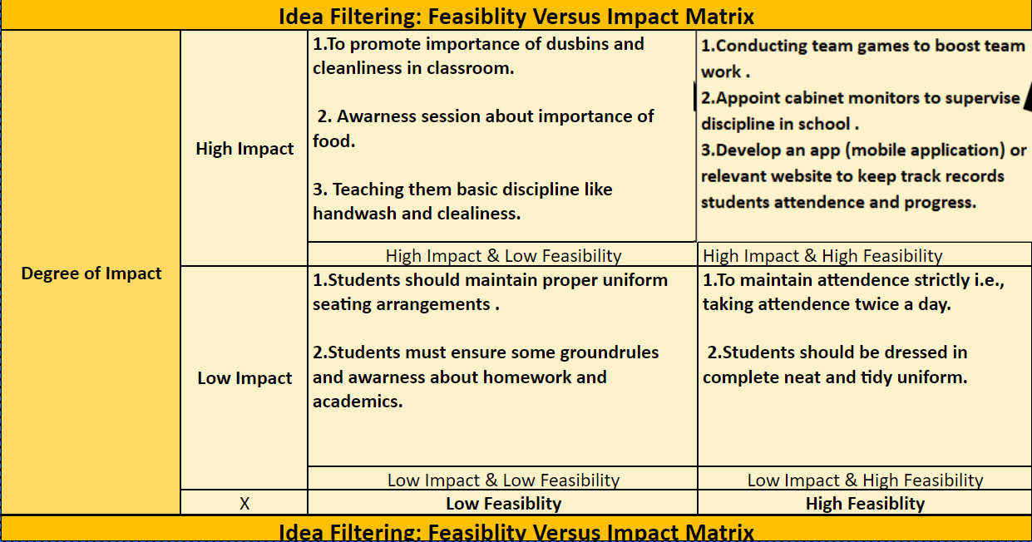
Generate solution for social Problem
Present the different Ideas generated
Show the finalized Idea

Slide 10

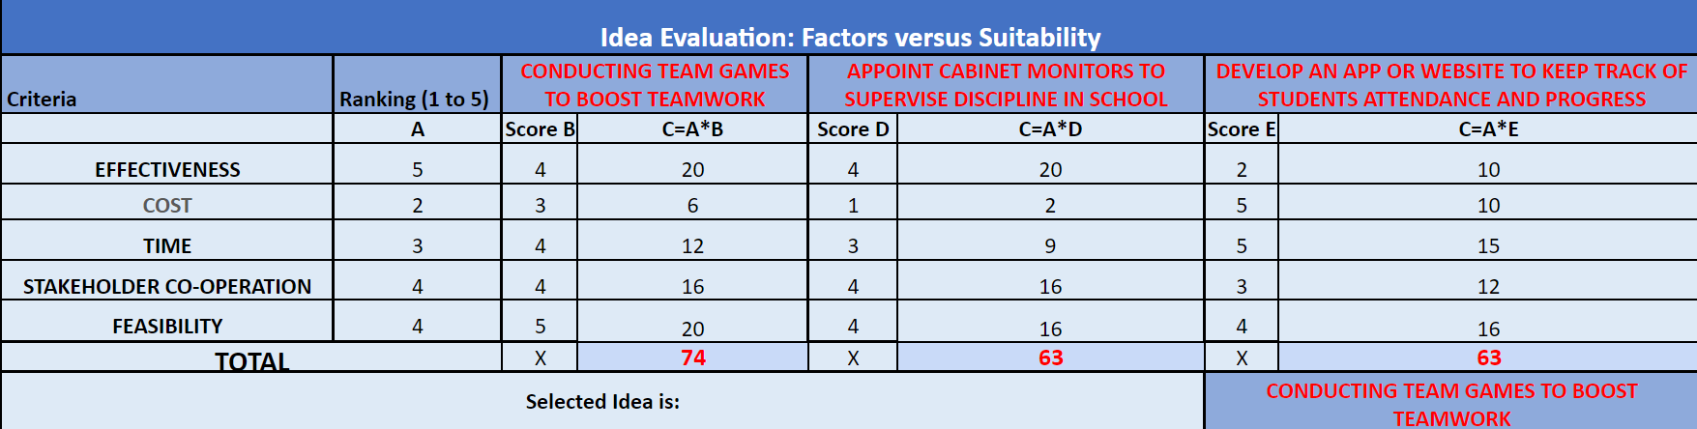
3
Generate solution for social Problem
Generate solutions.

Slide 11
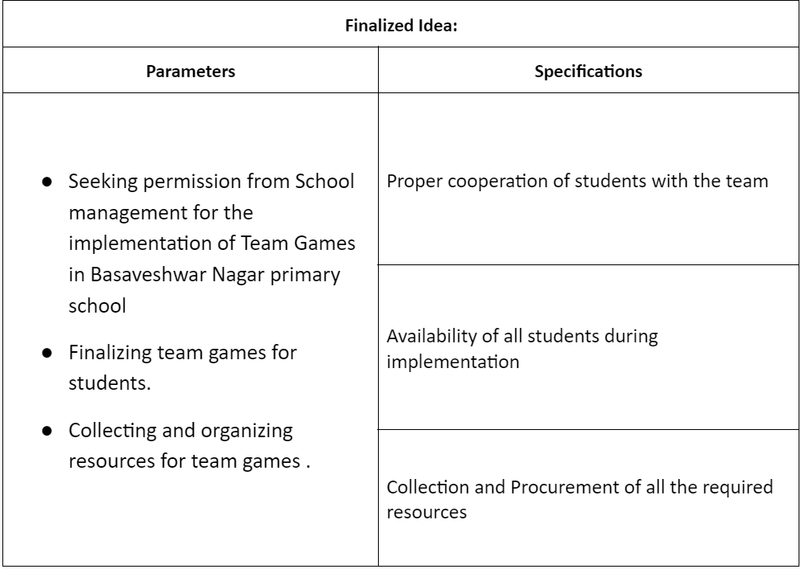
Specifications

Slide 12
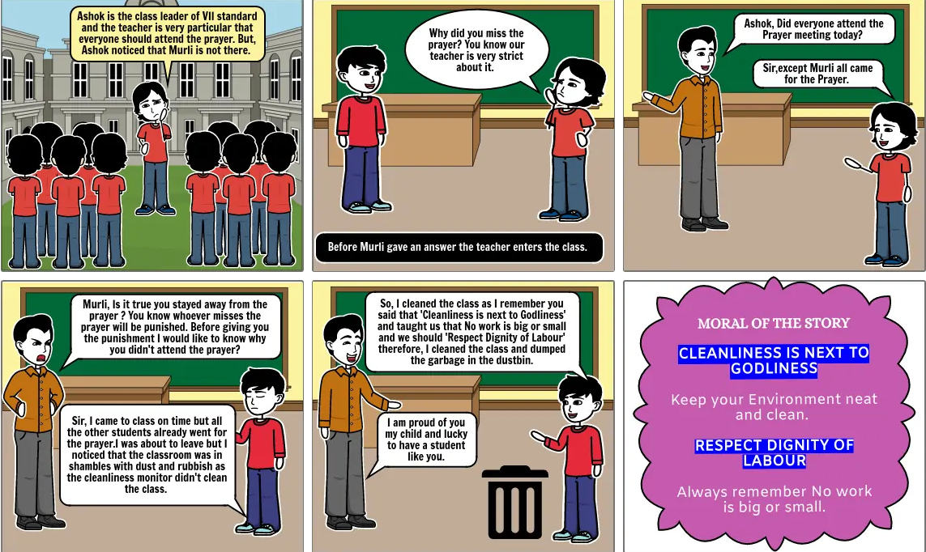
Proto Typing

Slide 13
Implementation
On 20th Dec 2023 , we have been visited to one of the Government School in Basaveshwar Nagar which is primary school from class 1st-8th class.
We had conducted Drawing contests and four of the games which inculcates team work and discipline .
The observation we found that students were well engaged in doing the provided task and were playing the games with collaboration among team members .

Slide 14

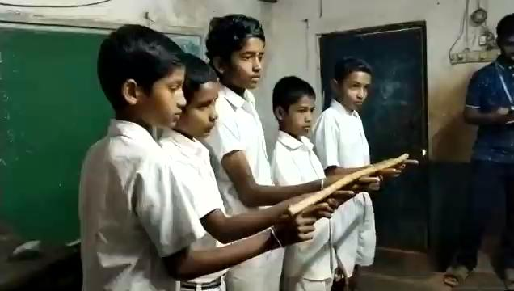
5
Implementation

Slide 15
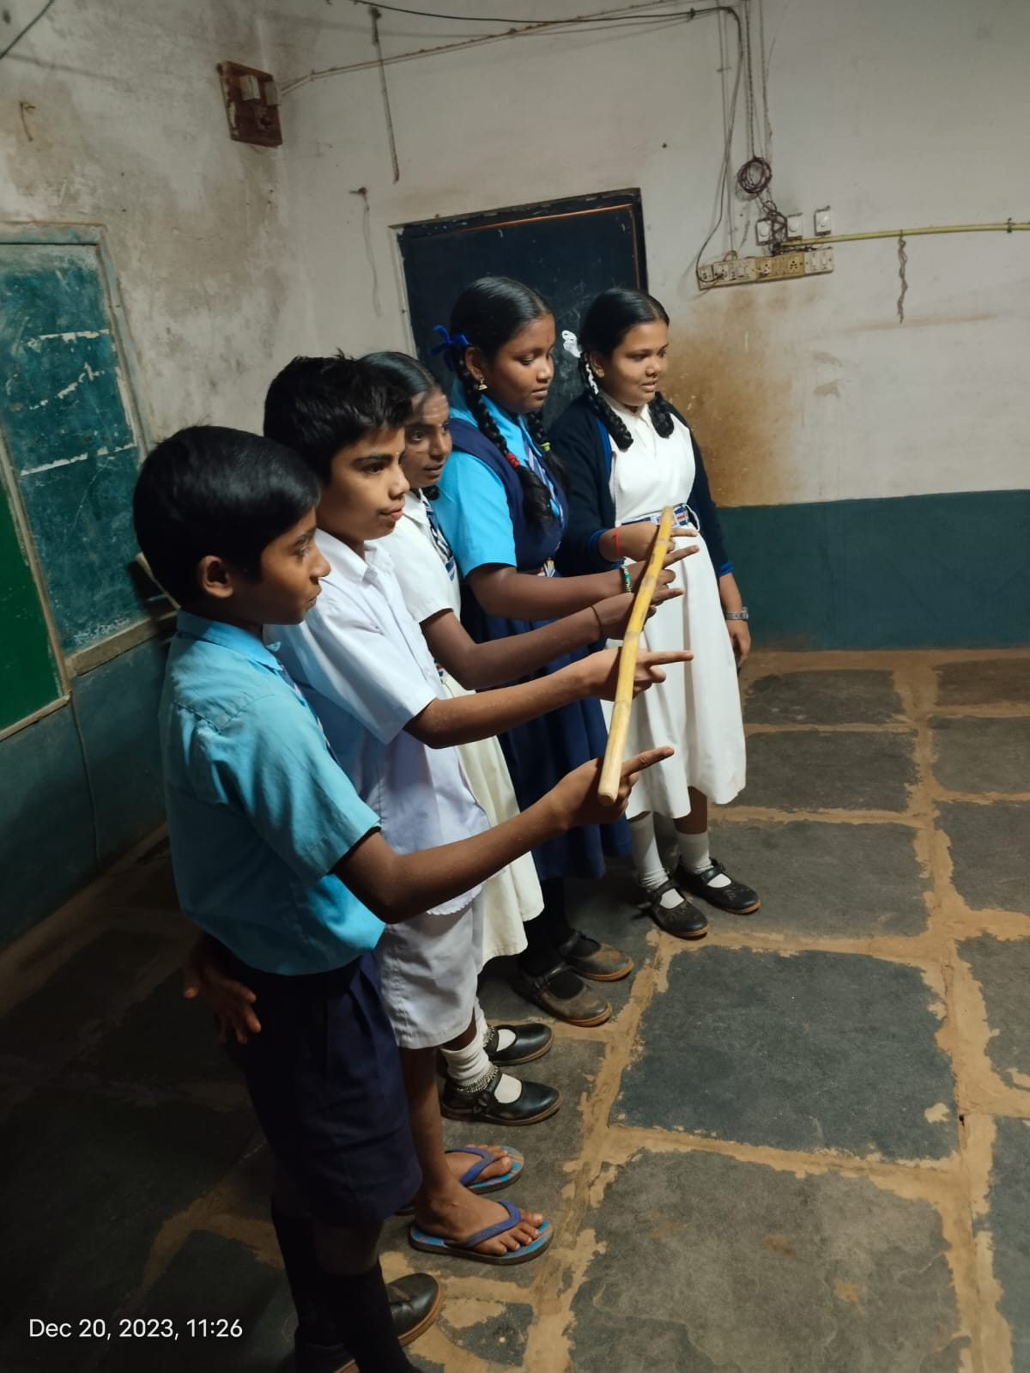
Helium Stick Game

Slide 16
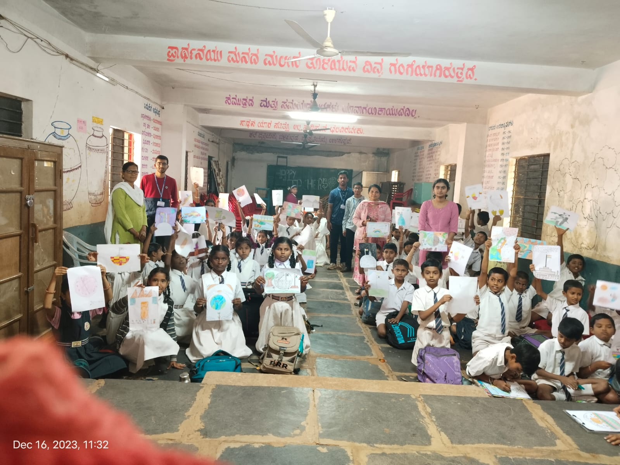
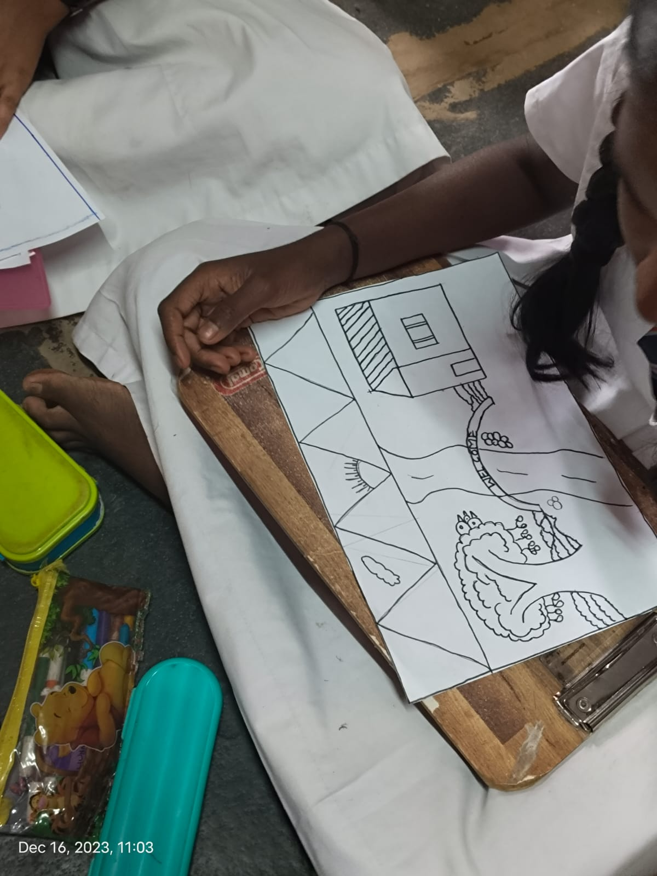
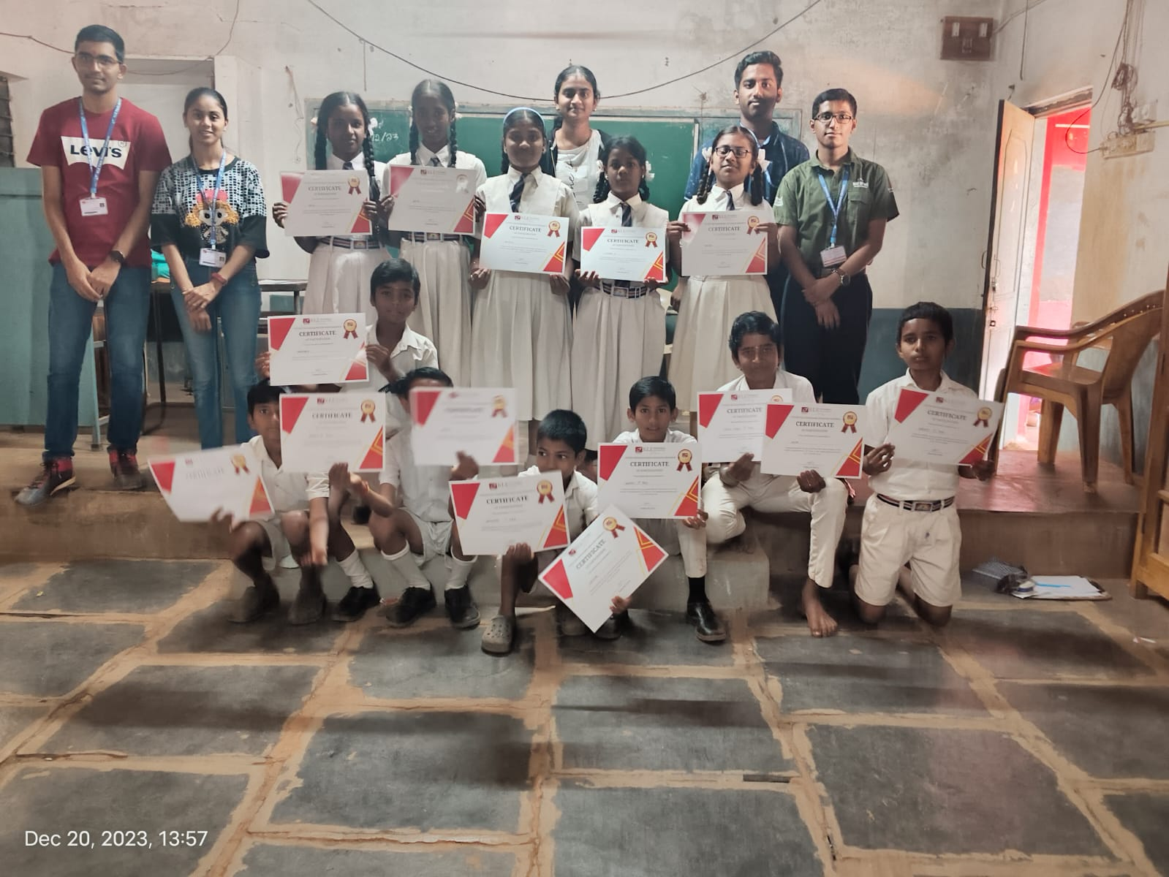
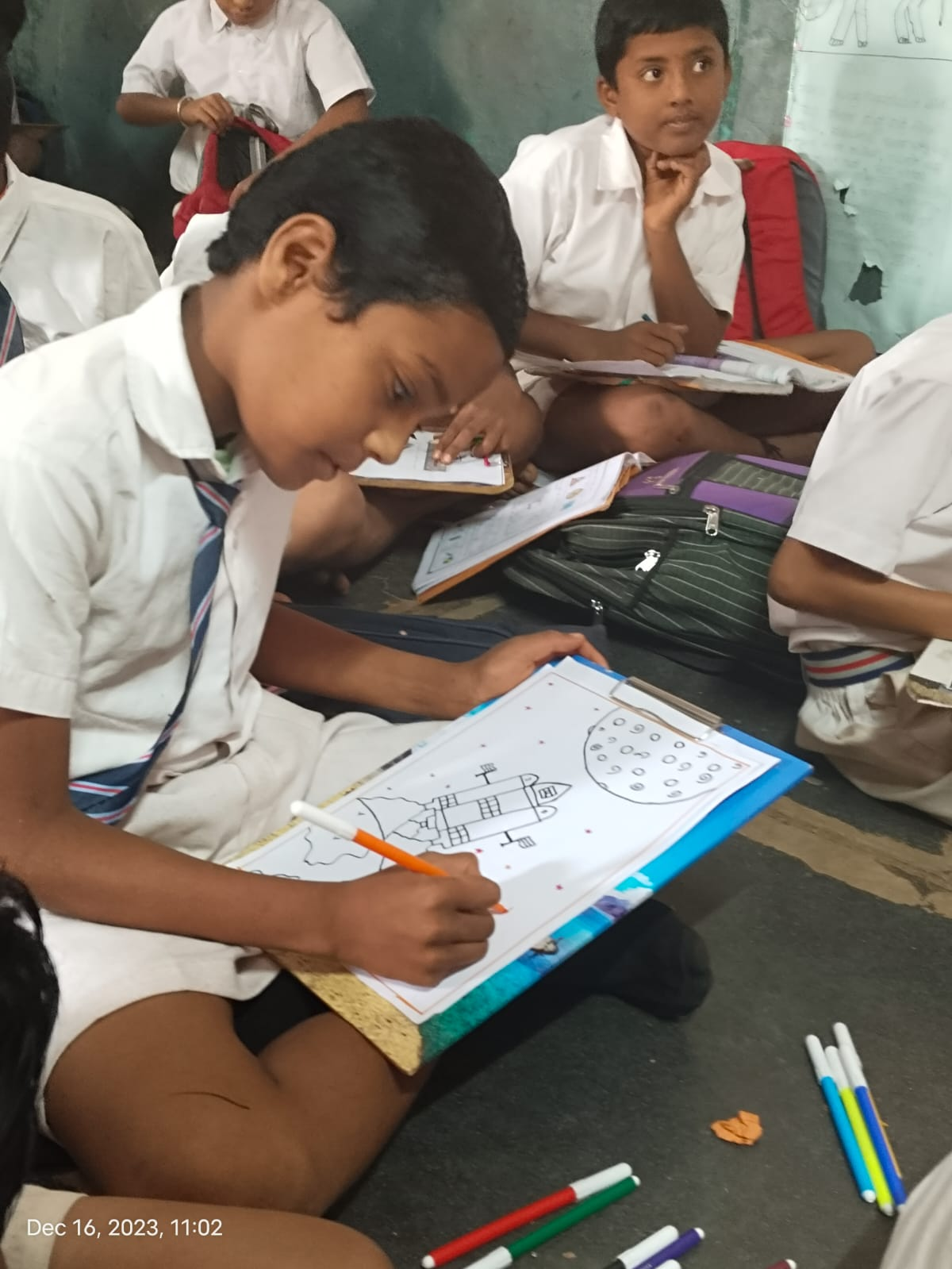

Slide 17
Learning from course project/DTSI course
List your learnings here and explain them briefly.

Slide 18


4
Develop solution for Social problem
Realize solutions.

Slide 19
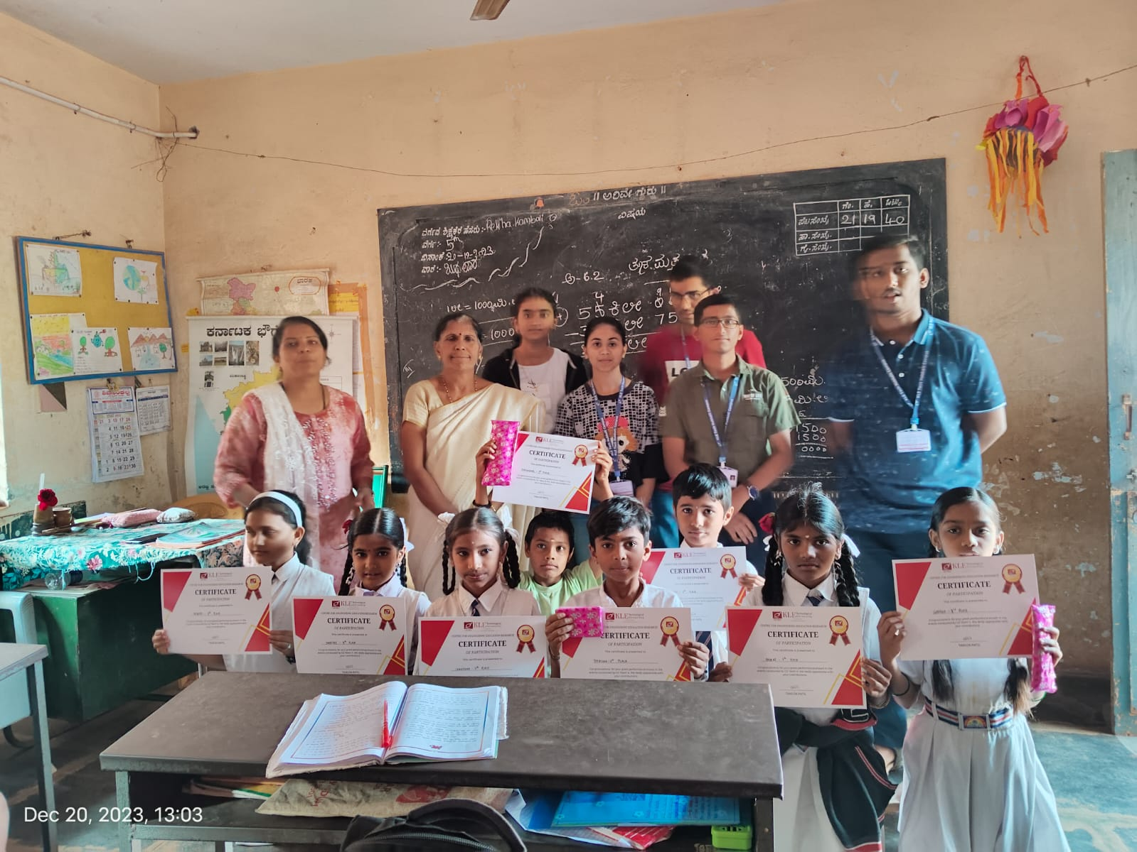
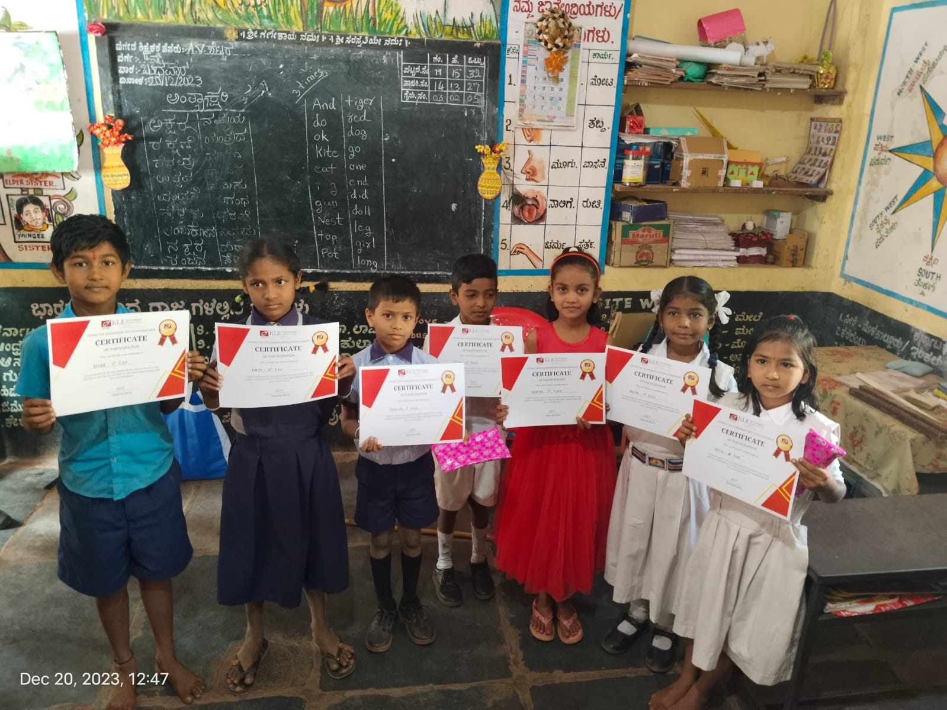
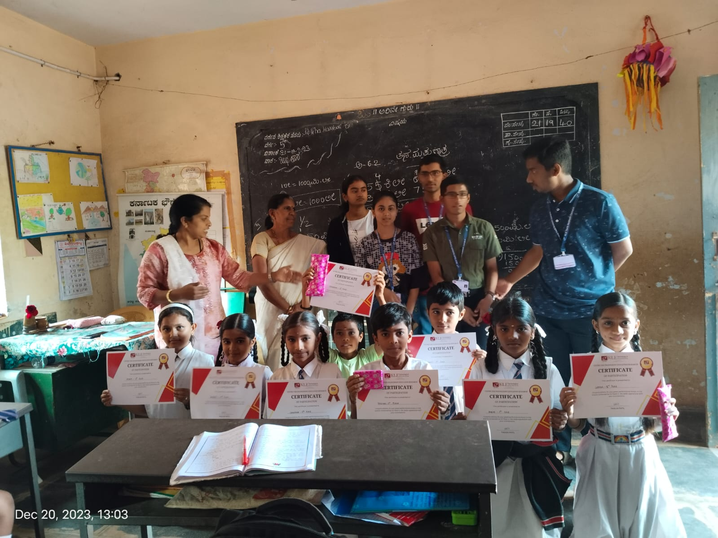

Slide 20
THANK YOU

